Slide 1
Getting Started:
Why Hadoop?

Slide 2
After this Part you will be able to..
Summarize the major goals of the Hadoop
Ecosystem
Look forward to the remaining Parts in this Module!

Slide 3


“The Hadoop Ecosystem is great for Big Data”
The 4 W’s (and H):
What’s in the ecosystem?
Why is it beneficial?
Where is it used?
Who uses it?
How do these tools work?

Slide 4
1. Enable Scalability
Major Goals
Commodity hardware is cheap
3
Rack
3

Slide 5
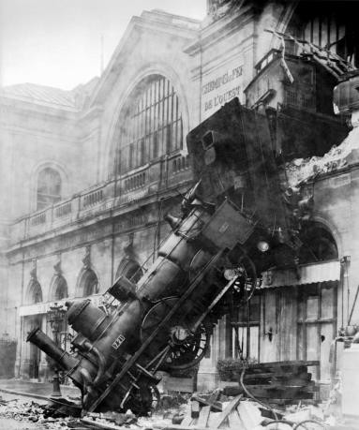
2. Handle Fault Tolerance
Be ready: crashes happen
Rack

Slide 6
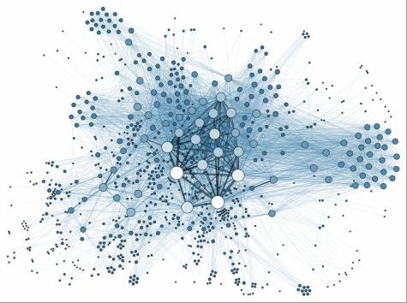
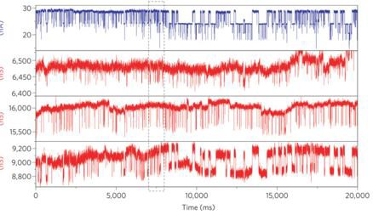
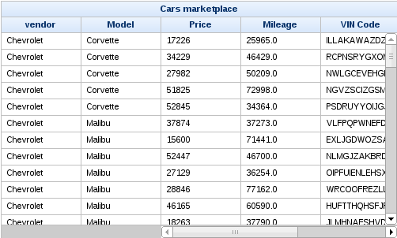
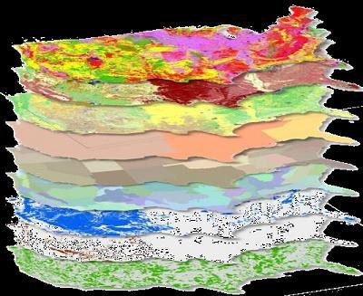
3. Optimized for a Variety Data Types

Slide 7
4. Facilitate a Shared Environment
Job
1 | 2 | 3 | 4 | 5
Rack

Slide 8


5. Provide Value
Community-supported
Wide range of applications

Slide 9


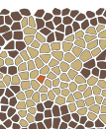











The rest of this Module…
The Hadoop Ecosystem
Hive
Pig
Giraph
Storm
Spark
Flink
MapReduce
YARN
HDFS
HBase
Zookeeper
Cassandra
MongoDB

Slide 10












The rest of this Module…
Main Hadoop Components
Hive
Pig
Giraph
Storm
Spark
Flink
MapReduce
YARN
HDFS
HBase
Zookeeper
Cassandra
MongoDB

Slide 11

The rest of this Module…
Cloud Computing
SaaS
PaaS
IaaS

Slide 12

The rest of this Module…
When to use Hadoop?
Hadoop
Hadoop

Slide 13


The rest of this Module…
Exercises

Slide 14
The Hadoop Ecosystem: So much free stuff!

Slide 15
After this Part you will be able to..
Differentiate the major layers in the Hadoop
ecosystem
Recognize key tools of the Hadoop ecosystem including HDFS, YARN, and MapReduce

Slide 16

Yahoo created
Hadoop in 2005

Slide 17




More Big Data frameworks released

Slide 18

















Now there’s over a 100!

Slide 19


Layer Diagram
D
B
C
A

Slide 20
One possible layer diagram for Hadoop
Hive
Pig
Giraph
Storm
Spark
Flink
MapReduce
YARN
HDFS
HBase
Zookeeper
Cassandra
MongoDB

Slide 21
One possible layer diagram for Hadoop
Higher levels:
Interactivity
Hive
Pig
Giraph
Storm
Spark
Flink
MapReduce
YARN
HDFS
Lower levels:
Storage and scheduling
HBase
Zookeeper
Cassandra
MongoDB

Slide 22
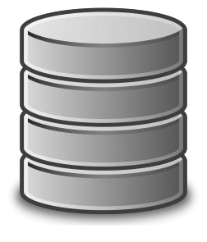


Distributed file system as foundation
Scalable storage
Fault tolerance
Hive
Pig
Giraph
Storm
Spark
Flink
MapReduce
YARN
HDFS
HBase
Zookeeper
Cassandra
MongoDB

Slide 23



Flexible scheduling and
resource management
YARN schedules jobs on
>^{Pi}4^{g} 0,000 servers at Yahoo
Hive
Giraph
Storm
Spark
Flink
MapReduce
YARN
HDFS
HBase
Zookeeper
Cassandra
MongoDB

Slide 24

Simplified programming model
Map → apply()
Reduce → summarize()
Hive
Pig
Giraph
Storm
Spark
Flink
MapReduce
^{YAR}G^{N} oogle used MapReduce
^{HD}f^{F}o^{S} r indexing web sites
HBase
Zookeeper
Cassandra
MongoDB

Slide 25
Higher-level programming models
Pig = dataflow scripting
Hive = SQL-like queries
Hive
Pig
Giraph
Storm
Spark
Flink
MapReduce
HBase
Cassandra
Zookeeper
Pig created at Yahoo,
MongoDB
YARN
Hive created at Facebook
HDFS

Slide 26
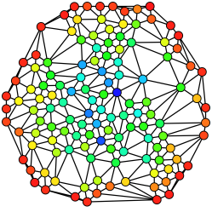

Specialized models
for graph processing
Giraph used by Facebook
to analyze social graphs
Hive
Pig
Giraph
Storm
Spark
Flink
MapReduce
YARN
HDFS
HBase
Zookeeper
Cassandra
MongoDB

Slide 27

Real-time and
in-memory processing
In-memory → 100x faster for some tasks
Hive
Pig
Giraph
Storm
Spark
Flink
MapReduce
YARN
HDFS
HBase
Zookeeper
Cassandra
MongoDB

Slide 28
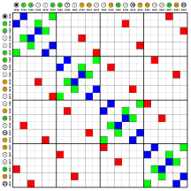
NoSQL for non-files
Key-values
Sparse tables
Hive
Pig
Giraph
Storm
Spark
Flink
MapReduce
HBase u_{Y}s_{AR}e_{N}d for Facebook’s
Messaging Platform
HBase
Zookeeper
Cassandra
MongoDB
HDFS

Slide 29

Zookeeper for management
Synchronization
Configuration
High-availability
Hive Pig
^{MapR}C^{ed}r^{u}e^{c}a^{e} ted by Yahoo to wrangle se_{Y}r_{A}v_{R}i_{N}ces named after animals
Giraph
Storm
Spark
Flink
HBase
Zookeeper
Cassandra
MongoDB
HDFS

Slide 30
All these tools are open-source

Slide 31

All these tools are open-source
Large community for support

Slide 32
All these tools are open-source
Large community for support
Download separately
or part of pre-built image

Slide 33



All these tools are open-source
Large community for support
Download separately
or part of pre-built image

Slide 34
Hive
Pig
Giraph
Storm
Spark
Flink
MapReduce
YARN
HDFS
HBase
Zookeeper
Cassandra
MongoDB
Growing number of open-source tools

Slide 35
YARN:
The Resource Manager
for Hadoop

Slide 36
After this Part you will be able to..
Outline how YARN provides flexible
resource management for Hadoop cluster
Explain how YARN extends Hadoop to enable multiple frameworks such as MapReduce, Giraph, Spark and Flink

Slide 37





HDFS Cluster Utilization
Share Hadoop across applications
Hive
Pig
Giraph
Storm
Spark
Flink
MapReduce
YARN
HDFS
HBase
Zookeeper
Cassandra
MongoDB

Slide 38
Hadoop evolved over time!
Hadoop 1.0
Hadoop 2.0
Hive
Pig
Others
Hive
Pig
Giraph
Storm
Spark
Flink
MapReduce
MapReduce
HBase
Zookeeper
Cassandra
MongoDB
YARN
HDFS
HDFS

Slide 39







Hadoop 1.0
Only MapReduce jobs
Other applications not supported
Hive
Pig
Others
MapReduce
HDFS
Poor Resource utilization

Slide 40











One dataset → many applications
HADOOP 1.0
HADOOP 2.0
MAP REDUCE
SPARK
OTHERS
MAP REDUCE
YARN
(Yet Another Resource Negotiator)
HDFS
HDFS

Slide 41
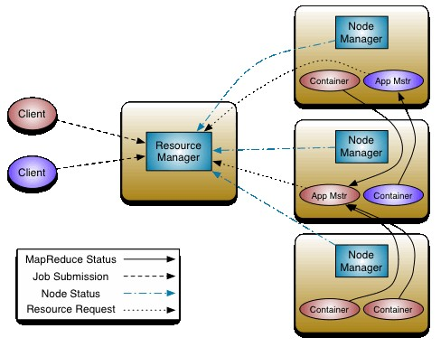
Central Resource Manager
Each machine gets a Node Manager
==
ultimate decision maker

Slide 42
Resource Manager
Node Manager
Data Computation
Framework

Slide 43
Container = a machine
Application Master = Personal
Negotiator

Slide 44



Essential gears in YARN engine
Resource Manager
Applications Master
Node Manager
Container

Slide 45




YARN → More Applications
Apache Hama
and growing …

Slide 46
Data → Value
Many choices in Hadoop 2.0
One dataset → Many applications
Higher Resource Utilization → Lower Cost

Slide 47
MapReduce:
Simple Programming for
Big Results

Slide 48
After this Part you will be able to..
Explain how MapReduce simplifies
creating parallel programs
Design a WordCount application using the MapReduce programming model

Slide 49
MapReduce = Programming Model for Hadoop Ecosystem
Hive
Pig
Giraph
Storm
Spark
Flink
MapReduce
YARN
HDFS
HBase
Zookeeper
Cassandra
MongoDB

Slide 50

Parallel Programming = Requires Expertise
Semaphores
Threads
Monitors
Message
Passing
Shared
Memory
Locks

Slide 51
MapReduce = Only Map and Reduce!
Semaphores
Threads
Monitors
Message
Passing
Shared
Memory
Locks

Slide 52
Based on Functional Programming
Map = apply operation
to all elements
f (x) = y
Reduce = summarize
operation on elements

Slide 53


Example MapReduce Application: WordCount
File 1
Result File
File 2
WordCount
File N

Slide 54
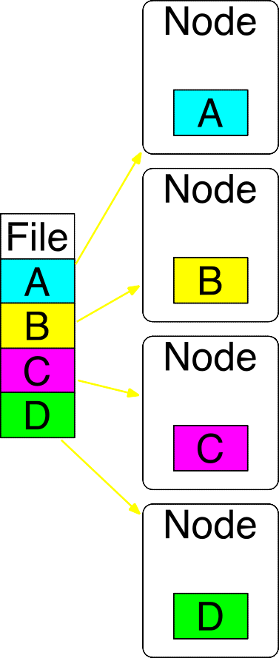
Step 0: File is stored in HDFS

Slide 55
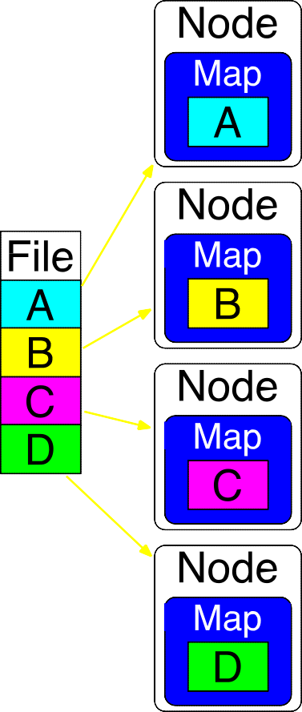
Step 1: Map on each node
My apple is red and my rose is blue....
…
You are the apple of my eye....
…
…
…

Slide 56
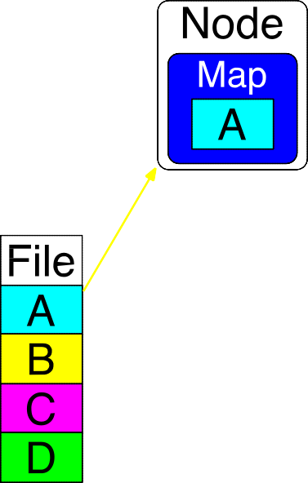
Map generates
key-value pairs
My apple is red and my rose is blue....
…
my, my → (my, 1), (my, 1)
apple → (apple, 1)
is, is → (is, 1), (is, 1)
red → (red, 1)
and → (and, 1)
rose → (rose, 1)
blue → (blue, 1)

Slide 57
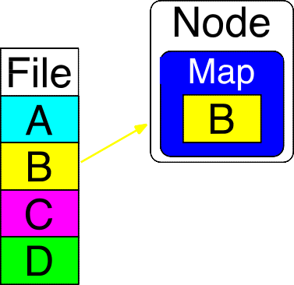
Map generates
key-value pairs
You are the apple of my eye....
…
You → (You, 1)
are → (are, 1)
the → (the, 1)
apple → (apple, 1)
of → (of, 1)
my → (my, 1)
eye → (eye, 1)

Slide 58
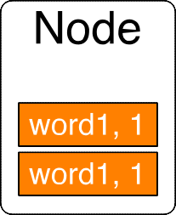
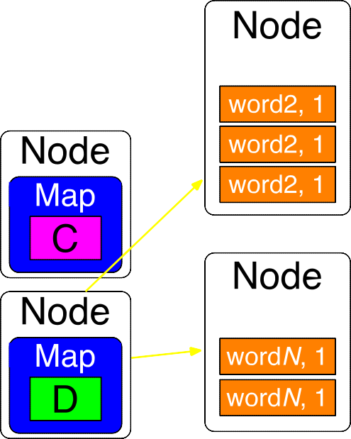
Step 2: Sort and Shuffle
Pairs with same key moved to same node

Slide 59
(You, 1)
Step 2: Sort and Shuffle
(apple, 1)
Pairs with same key moved to same node
(apple, 1)
(is, 1)
(is, 1)
(rose, 1)
(red, 1)

Slide 60
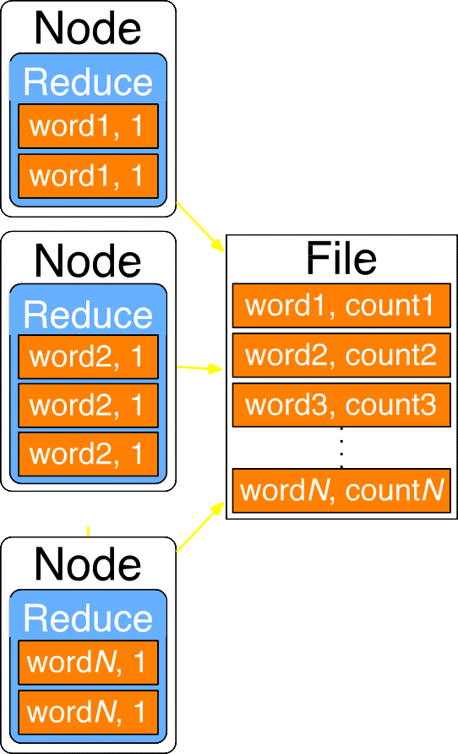
Step 3: Reduce
Add values for same keys

Slide 61
Step 3: Reduce
Add values for same keys
(You, 1)
(You, 1)
(apple, 1), (apple, 1)
(apple, 2)
(my, 1), (my, 1),
(my, 1)
(my, 3)
(red, 1)
(red, 1)
(rose, 1)
(rose, 1)

Slide 62
Shuffle
and Sort
Map
Reduce
Represents a large
number of applications.

Slide 63
Shuffle
and Sort
Map
Reduce

Slide 64
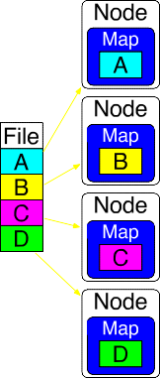
Shuffle
and Sort
Map
Reduce
Parallelization
over the input

Slide 65
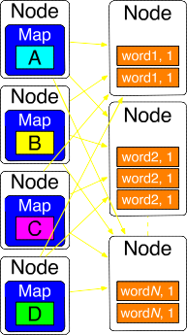
Shuffle
and Sort
Map
Reduce
Parallelization over the input
Parallelization
data sorting

Slide 66
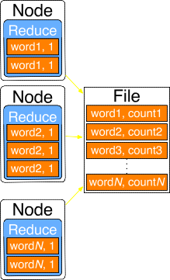
Shuffle
and Sort
Map
Reduce
Parallelization over the input
Parallelization over data groups
Parallelization over
intermediate data

Slide 67
MapReduce is bad for:

Slide 68
MapReduce is bad for:
Frequently changing data

Slide 69
MapReduce is bad for:
Frequently changing data
Dependent tasks

Slide 70
MapReduce is bad for:
Frequently changing data
Dependent tasks
Interactive analysis

Slide 71
MapReduce
Simplified parallel programming
Applications with independent data- parallel tasks

Slide 72
Cloud Computing:
An Important Big Data
Enabler

Slide 73
After this Part you will be able to..
Make the case for the business value of
Cloud Computing
Express how the elasticity of Cloud Computing provides value for dynamic businesses

Slide 74
Data Science →
Cloud Computing
#1 Catalyst for economic growth!
-McKinsey

Slide 75
Computing
anywhere and anytime

Slide 76
Computing
anywhere and anytime
On-Demand
Computing

Slide 77




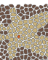











Cloud → Keep focus on solving
your problem
Hive
Pig
Giraph
Storm
Spark
Flink
MapReduce
YARN
HDFS
HBase
Zookeeper
Cassandra
MongoDB

Slide 78
Cloud =
IT infrastructure & Applications on Rent over the Internet

Slide 79



Cloud =
IT infrastructure & Applications on Rent over the Internet

Slide 80




Cloud =
IT infrastructure & Applications on Rent over the Internet

Slide 81



BUILD
RESOURCES
CLOUD

Slide 82
BUILD RESOURCES

Slide 83

BUILDING HARDWARE → MORE WORK
STORAGE
NETWORKING
PROCESSORS
UPGRADES
BUILD
RESOURCES

Slide 84



Hardware estimation is hard
Over
Estimation
Under
Estimation
BUILD
RESOURCES

Slide 85

Software Stacks are complex
LATEST
COMPATIBLE
INSTALLATION
BUILD
RESOURCES

Slide 86



HARDWARE ISSUES
SOFTWARE
ISSUES
CHALLENGES
BUILD
RESOURCES

Slide 87

High Capital Investments
MAINTAINANCE
PROCUREMENT
DISPOSAL
QUALITY CONTROL
BUILD
RESOURCES

Slide 88
CLOUD

Slide 89


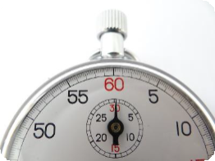


PAY AS YOU GO
QUICK IMPLEMENTATION
CLOUD

Slide 90

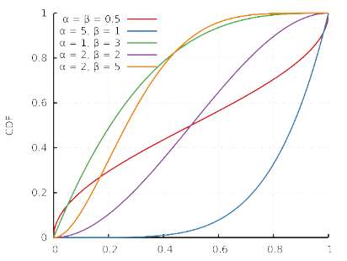


DEPLOY CLOSER TO YOUR CLIENT
RESOURCE ESTIMATION SOLVED
CLOUD

Slide 91


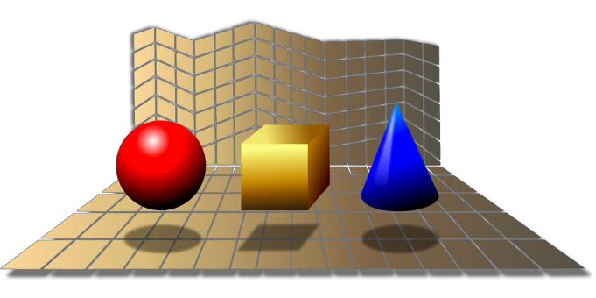

WORK ON YOUR DOMAIN EXPERTISE
CPU GPU… INSTANTLY GET DIFFERENT RESOURCES
CLOUD

Slide 92






DESIGN YOUR OWN COMPUTING PLATFORM CPU MEMORY DISK…
BUFFET
CLOUD

Slide 93


















Cloud Computing Providers

Slide 94

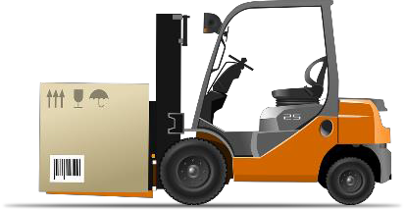
Focus on domain expertise
Your Team
Excellent value
proposition
Scalability
Cloud
Resource Management

Slide 95
When to reconsider Hadoop ?

Slide 96
After this Part you will be able to..
Evaluate when your team should use Hadoop based on your organization and project
Identify problems where Hadoop may not
be the best candidate

Slide 97

Long term availability of data
Future anticipated data growth
Hadoop

Slide 98
High Volume
Many platforms over single data store
High Variety
Hadoop

Slide 99





Small Datasets

Slide 100







Task Level Parallelism
TASK A
TASK 2
OUT
IN
TASK N

Slide 101

Advanced Algorithms

Slide 102

Replacement to your
infrastructure

Slide 103

Random Data Access

Slide 104

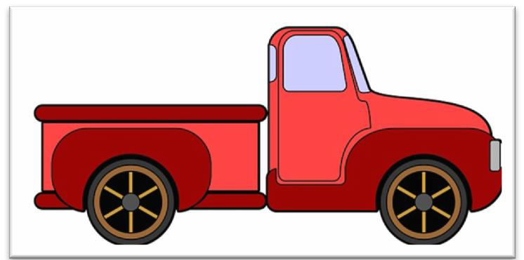
Advanced Analytical Queries
https://tez.apache.org/
https://drill.apache.org/, http://storm.apache.org/
Latency sensitive tasks Security of Sensitive Data
http://ranger.apache.org

Slide 105
Advanced Algorithms
Small Datasets
Infrastructure
Replacement
Task Level
Parallelism
Random Data
Access

Slide 106
Value from Hadoop and Pre-built Hadoop Images

Slide 107
After this Part you will be able to..
Identify how to quickly generate value by
using the Hadoop Pipeline
Extract benefits by leveraging pre-built images of the Hadoop Ecosystem by companies like Cloudera and Hortonworks

Slide 108


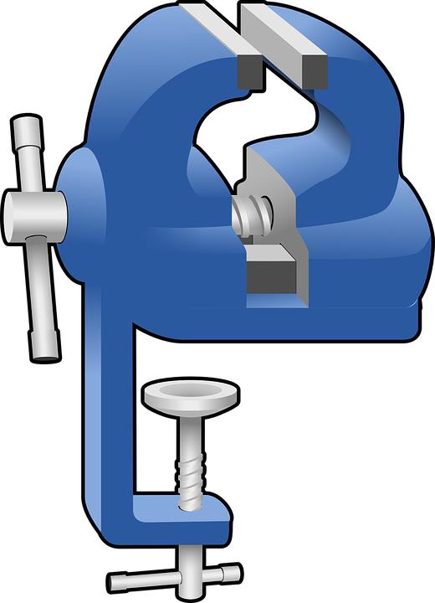

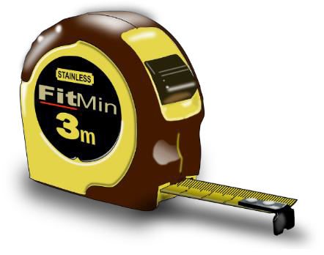
Download, Configure, Install

Slide 109



Pre-built Software images

Slide 110


Virtualization software
...

Slide 111
Pre-built Images for Hadoop

Slide 112
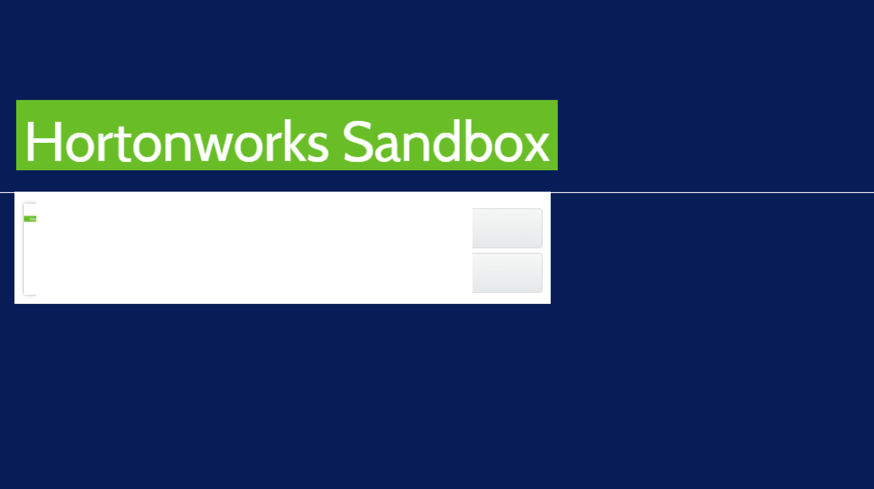
for VirtualBox
Mac & Windows [È)
for Vi rtualBox
(H)P 2.32-8.5 GBI
INSTALL
GUIDES
for VMw'are
Mac & Windows [ÈÎ
for VMware
(HOP 2.32 - 87 GB

Slide 113
loudera

Slide 114
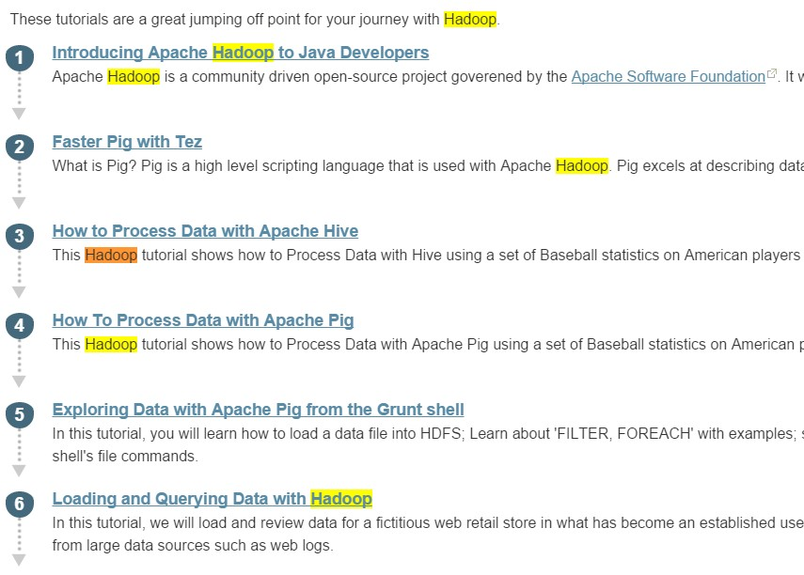
http://hortonworks.com/tutorials/

Slide 115
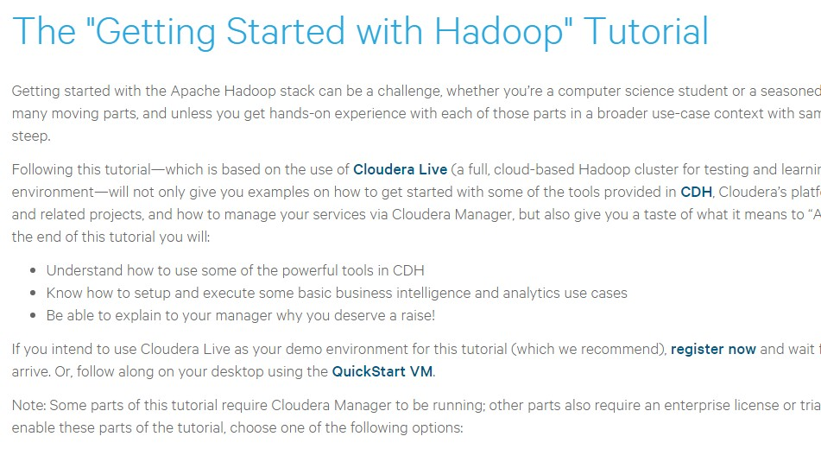
http://www.cloudera.com/developers/get-started-
with-hadoop-tutorial.html

Slide 116
Deploying pre-built images on Cloud

Slide 117
Many off the shelf solution options
Test and validate Ideas
Scale developed solutions

Slide 118
Cloud Service Models:
Exploration of Choices

Slide 119
After this Part you will be able to..
Differentiate among the three standard Cloud Service Models and how to pick the right one
Name example cloud service
providers for each service model

Slide 120
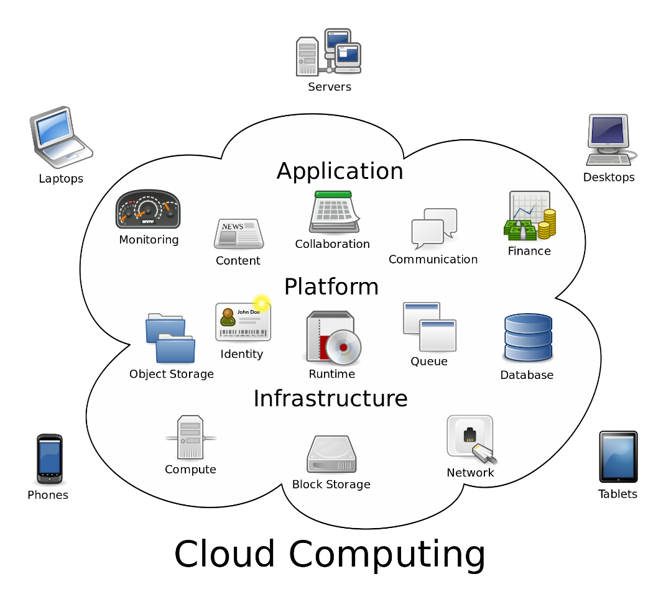
Service Model
Different levels of
engagement

Slide 121
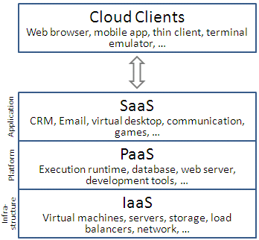
IaaS = Get the Hardware only
YOU
Install and maintain OS
Application Software

Slide 122
PaaS = Get the Computing Environment
YOU
Application Software

Slide 123
SaaS = Get full software on-demand
YOU
Domain Goals

Slide 124

Skills
Demand
Capital
Security

Slide 125

Skills
Demand
Capital
Security

Slide 126
XaaS = Anything as a Service
IaaS
PaaS
SaaS
Storage aaS
Marketing aaS
Communications aaS
aaS

Slide 127
PaaS
IaaS
AaaS
Amazon EC2
Microsoft Azure
Dropbox
XaaS = Anything as a Service

Slide 128
The Hadoop Distributed
File System (HDFS):
A Storage System for Big
Data

Slide 129
After this Part you will be able to..
Describe how HDFS provides scalable and
reliable storage
Differentiate two key HDFS components: the NameNode and the DataNode

Slide 130










Scalability
HDFS = foundation for
Hadoop ecosystem
Reliability
Hive
Pig
Giraph
Storm
Spark
MapReduce
YARN
HDFS
HBase
Zookeeper
Cassandra
MongoDB

Slide 131
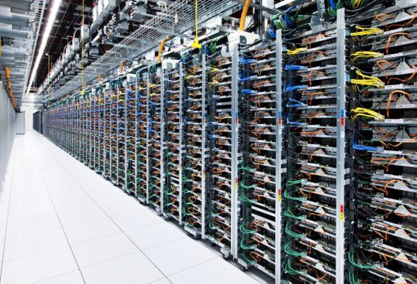
Store massively large
data sets
up to 200 Petabytes, 4500 servers,
1 billion files and blocks!

Slide 132
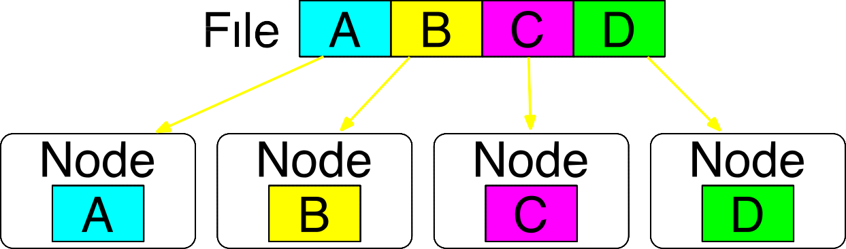
HDFS splits files across
nodes for parallel access

Slide 133
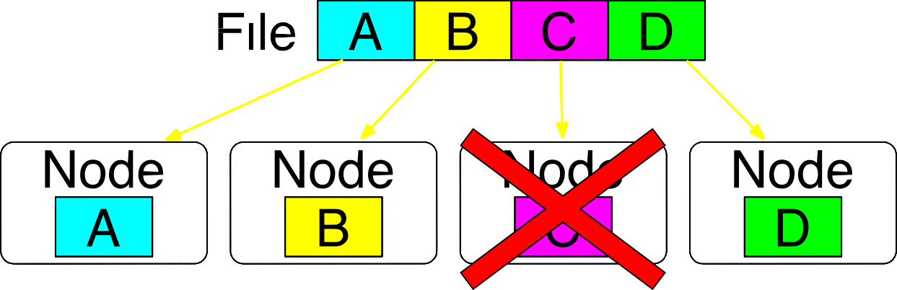
What happens if node fails?

Slide 134
Replication for fault tolerance
✔
✔

Slide 135
Customized reading to handle
variety of file types
Text
Lines
Words

Slide 136
Customized reading to handle
variety of file types
Text
GIS
^{Line} Vectors
^{Wor} Rasters
s
ds

Slide 137
Customized reading to handle
variety of file types
Text
GIS
Bio
^{Line Vect} FASTA ^{Wor Ras} FASTQ
s
ors
ds
ters

Slide 138
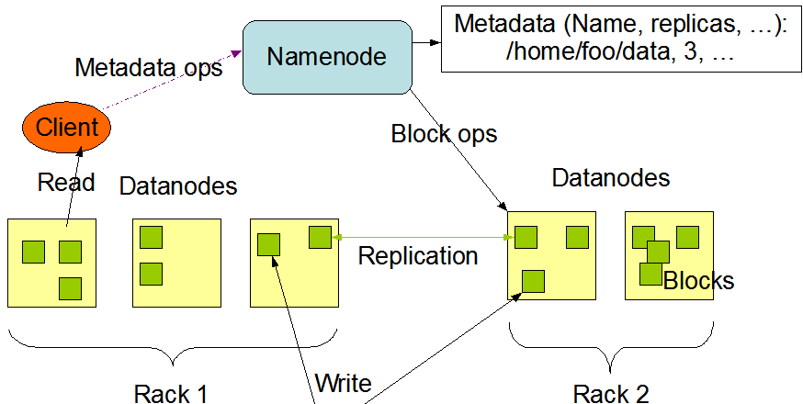
Two key components of HDFS
1. NameNode for metadata
2. DataNode for block storage

Slide 139


Two key components of HDFS
NameNode for metadata
Usually one per cluster
DataNode for block storage
Usually one per machine

Slide 140
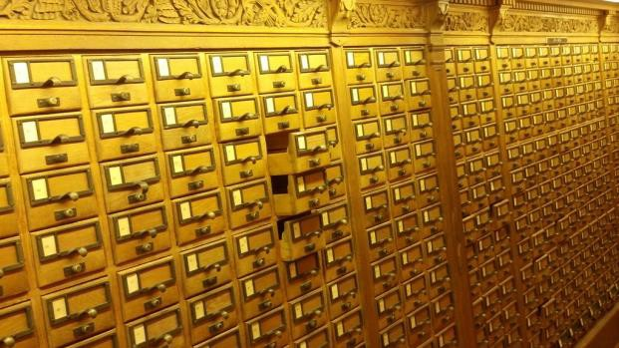
The NameNode
coordinates operations
Keeps track of file name,
location in directory, etc.
Mapping of contents
on DataNode.

Slide 141
DataNode stores file blocks
Listens to NameNode for block creation, deletion, replication

Slide 142
DataNode stores file blocks
Listens to NameNode for block creation, deletion, replication
Fault Tolerance
Data locality

Slide 143
Data partitioning
Scalability
Data replication
Fault tolerance
Data locality
✔
✔

